Slide 1
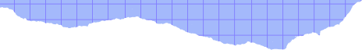




Aditya Kumar
Yash Golani
Analysis of
FLUID FLOWS

Slide 2





Introduction to POD-SVD
Clean image analysis
Noise analysis
Denoise using Gaussian Blur & NLM denoising
Agenda

Slide 3
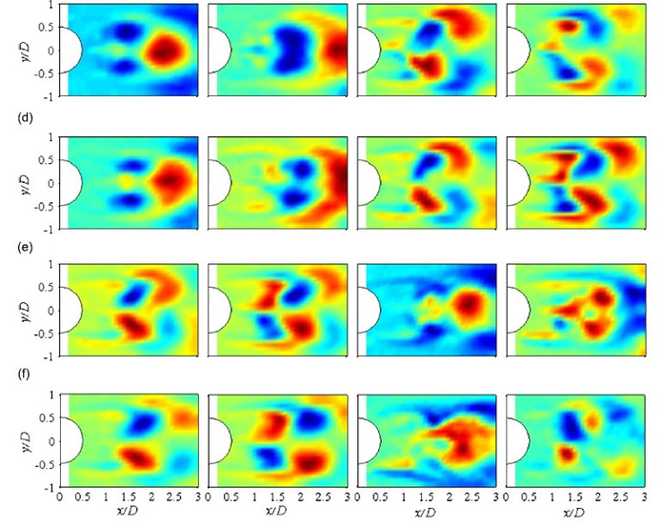




INTRODUCTION TO POD AND ITS SIGNIFICANCE IN FLOW SIMULATIONS
Feature Extraction
Reduction in complexity of complex systems,
Flow Simulation Systems often deal with complex data systems with a large number of features and dimensions
However, one must understand that all data is not relevant and there is always redundancy in data sets, here comes the role of feature extraction
With techniques such as PCA/POD, we aim to reduce the dimensions of the data while preserving maximum variance
With POD, we identify the dominant features of the data and isolate them to reduce computational complexity.

Slide 4
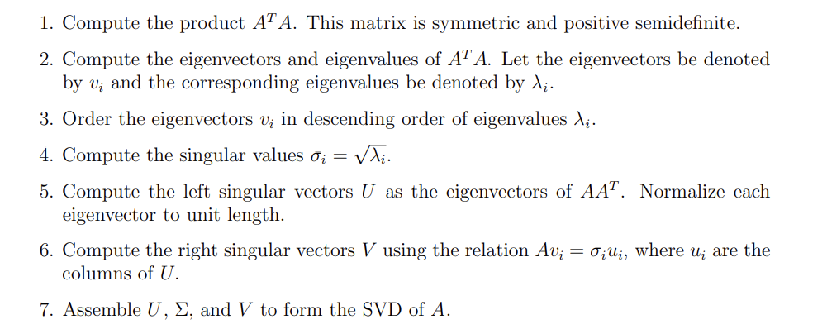
BUT HOW ARE WE IMPLEMENTING IT?
SVD!
A = UΣVt
A is the original matrix of size m × n.
U is an orthogonal matrix of size m × m containing the left singular vectors.
Σ is a diagonal matrix of size m × n containing the singular values.
V T is an orthogonal matrix of size n × n containing the right singular vectors.

Slide 5
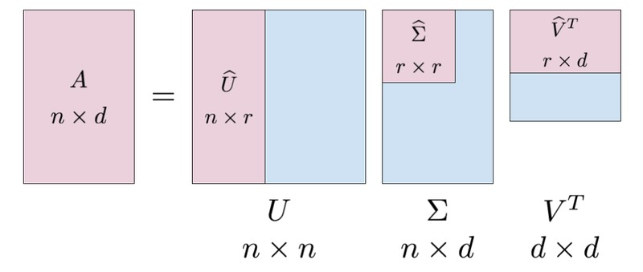
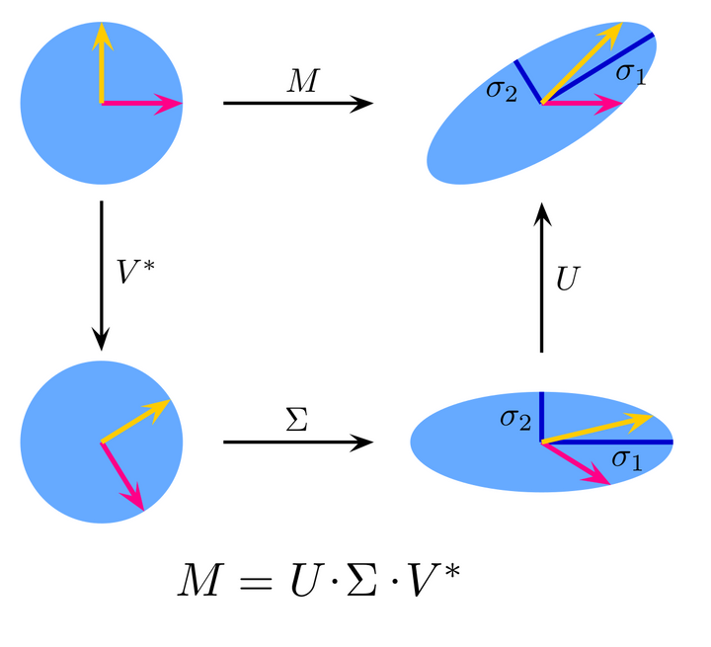

Slide 6
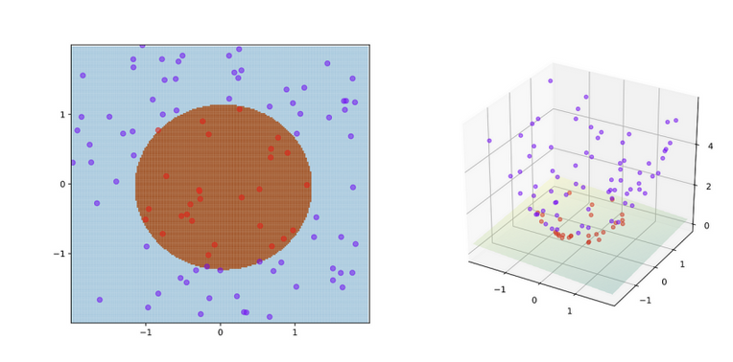
NEW IDEAS?
Support Vector Machines for De-noising Images:
Support Vector Machine (SVM) is primarily used for classification tasks. Typically, it is not employed for removing noises from images.
SVMs work by finding the optimal hyperplane that separates data points into different classes by projecting them into a higher dimension.
We can train the SVM model to identify between clean and noisy images for a given flow, by splitting into train and test data sets. The higher energy pixels can be filtered out. But we are working on the assumption that it is Gaussian Noise. It can be used to classify image patches as noisy or noise-free.
HMM(Hidden Markov Models) for predicting fluid flow(like weather prediction)
HMM can be used to predict future fluid flow, which is not directly observable but can be inferred from the data at hand.
In HMM, we have probability distributions for various eventualities that could happen, based on past data.
An adjacency matrix can be made based on the various probabilities of past flows at same positions, and based on that we can produce new flows.
I

Slide 7
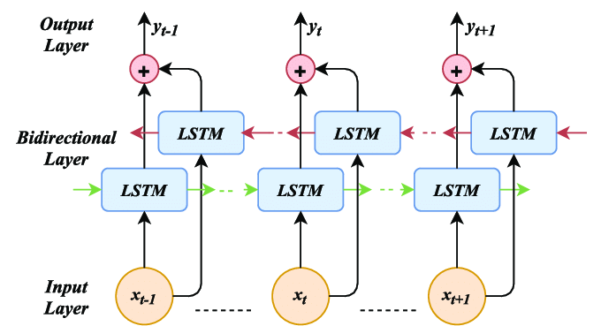
NEW IDEAS?
Bi-Directional LSTM for Fluid state prediction:
Bi-directional LSTMs are mainly used in two layers, the first layer analyzes the data from the past states of the system and the second one from the future states of the system.
While analysing Fluid Flows in Computational Fluid Dynamics, LSTM algorithms can be used based on data from previous time intervals, and prediction of future flow patterns can be made.
LSTM is generally used for topics such as sentiment-based Stock Price Prediction, Sales Forecasting, etc.
Estimation of Dimensionless Nos. obtained in Dimensional analysis of Navier Stokes Equation
We can employ Linear Regression to estimate the various dimensionless quantities such as Reynold’s no., Strouhal no., and Euler’s no.
An exhaustive dataset can be created for a specific fluid after doing numerous experiments, and that dataset can be trained upon, and finally, numerous applications can be found for this.
This offers a reliable means of predicting dimensionless parameters. I

Slide 8
As a part of image extraction and data preparation, we followed several steps:
First, we extracted frames from the video at defined time interval (0.5s) and then stored it in a folder. We provided the provision for deletion of said folder if the code is run again because inconsistencies can occur at run time.
Then we allowed for the provision of down-sampling of images should the need arise if we were to work with larger no. of frames.
Next, we stacked the images into a 2D matrix where each row represent an image.
Next, we found the mean of said stacked images, mean-centralized the data matrix and finally passed said data matrix to SVD function of linalg library, which provided us with spacial modes U, Singular values(sigma) and temporal modes (Vt)
Next, we found the cumulative variance and found the no of modes that explained 95% variance, which we then used to reduce the decomposed components of original matrix and and then used the reduced components to show reconstructed images.
We have provided for code modularity to prevent runtime ram crashes, so each question can be run independently.
IMAGE EXTRACTION

Slide 9
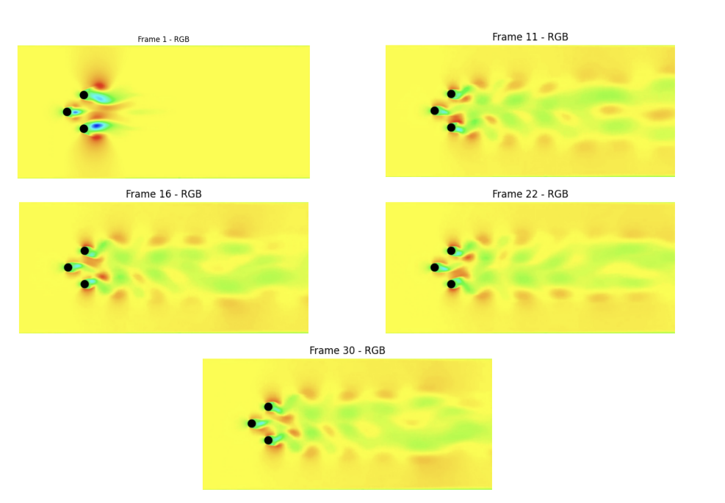
IMAGE EXTRACTION

Slide 10
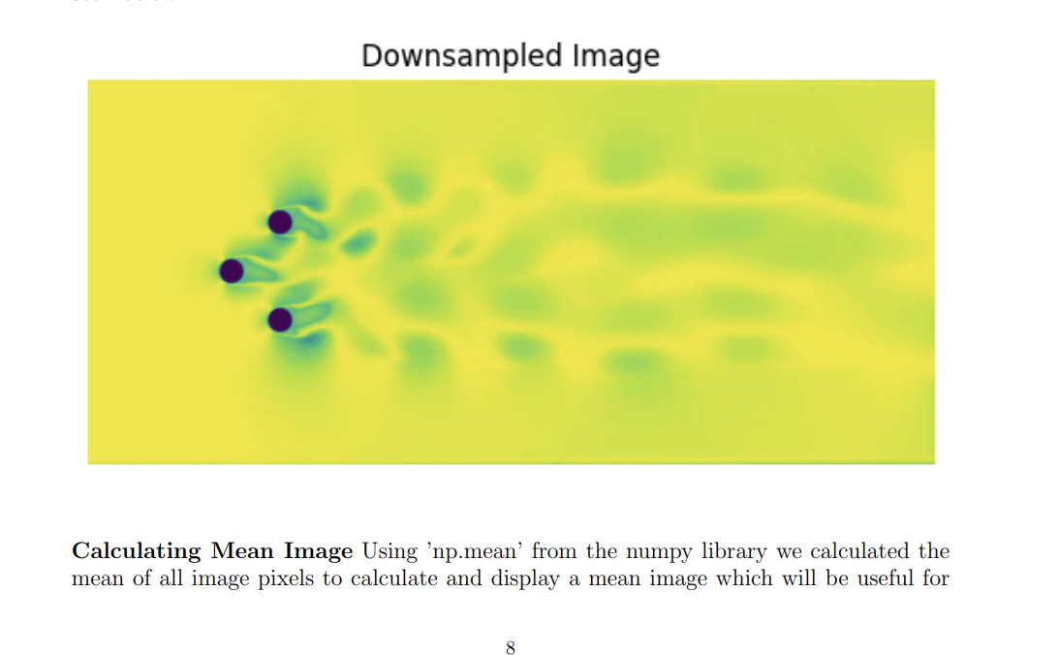
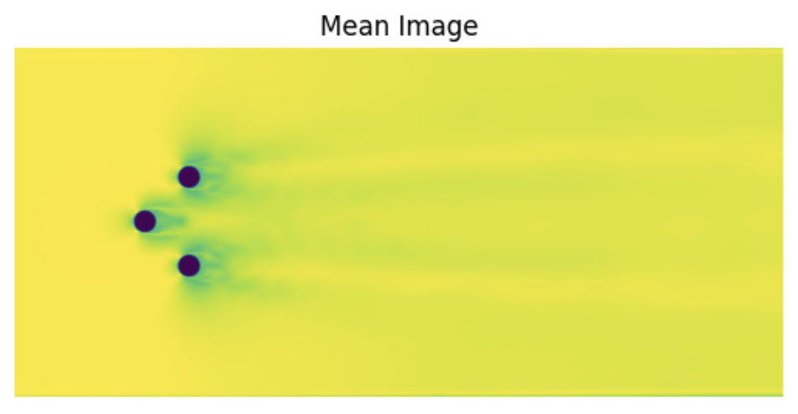
DOWNSAMPLING& MEAN CALCULATION
To decrease Computational complexity, we decided to keep provision for downsampling of the pictures to decrease the size of the pixels in a fixed ratio, so that later on, the time interval between snapshots can be decreased and a larger number of frames can be considered

Slide 11
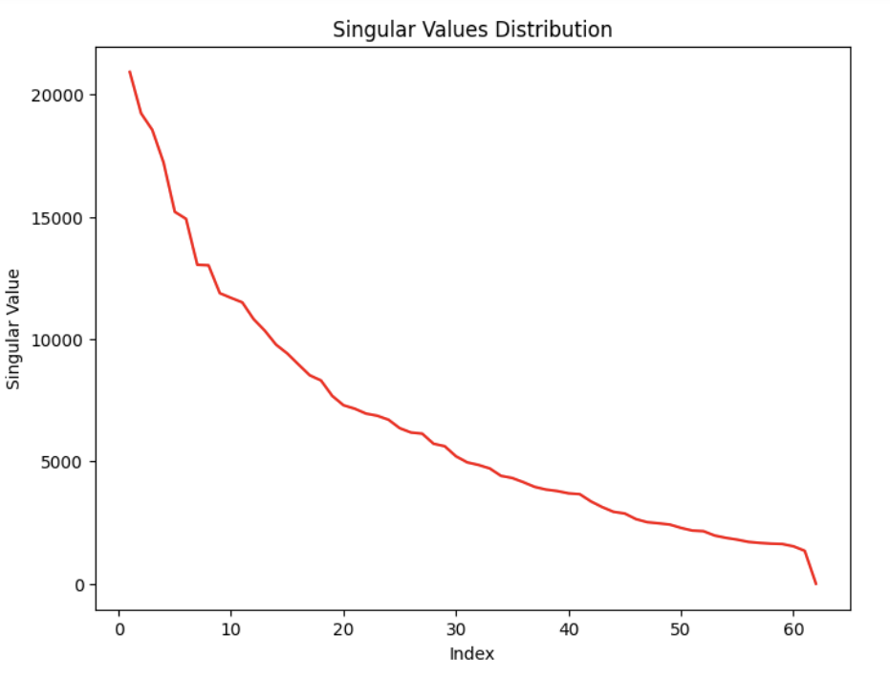
THE MATRIX S!
We can observe a sharp decrease in values from the initial indices, indicating that the primary modes include a substantial portion of the energy within the fluid flow.
With increasing indices, the singular values decrease, implying a decreasing contribution from these higher-indexed modes to the overall flow structure.

Slide 12
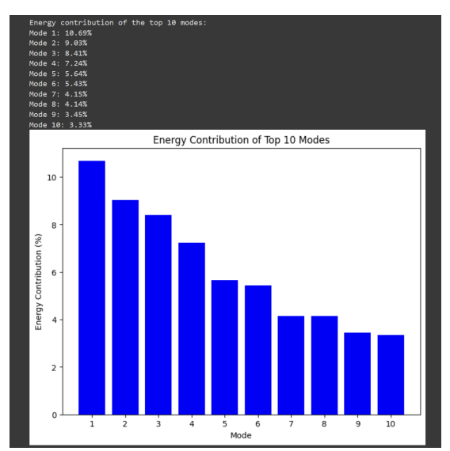
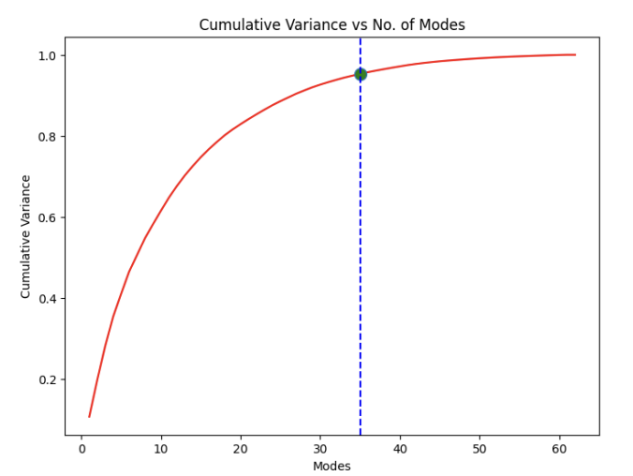
EXPLORING THE RESULTS
Number of modes that justify 95 % of the variance: 35

Slide 13
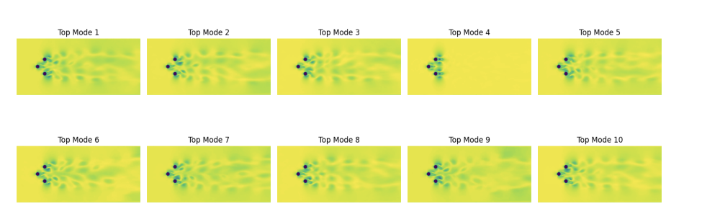
EXPLORING THE RESULTS
Number of modes that justify 95 % of the variance: 35

Slide 14
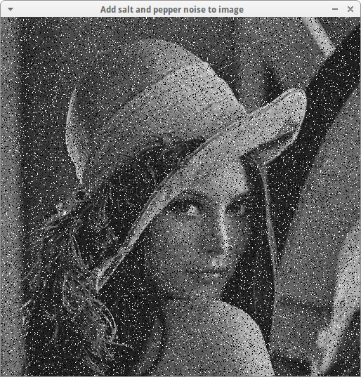
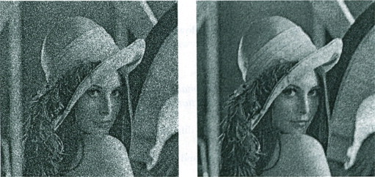
NOISE!
GAUSSIAN NOISE
SALT -PEPPER
In the context of image processing, Gaussian noise manifests as random variations in pixel intensity values, mimicking the effects of noise present in images captured by cameras or other imaging devices.
Salt-and-pepper noise is a form of visual noise that appears as random black (pepper) and white (salt) specks scattered on the image. This noise typically represents sharp and sudden disturbances in the image data.

Slide 15
ADDED NOISE, BUT HOW?
ADDING GAUSSIAN NOISE:
IN THE ADD_GAUSSIAN_NOISE FUNCTION, GAUSSIAN NOISE IS ADDED TO AN INPUT IMAGE.
THE MAGNITUDE PARAMETER CONTROLS THE STRENGTH OF THE NOISE TO BE ADDED, EXPRESSED AS A PERCENTAGE OF THE MAXIMUM PIXEL INTENSITY (255 FOR AN 8-BIT IMAGE).
THE STANDARD DEVIATION (STD_DEV) OF THE GAUSSIAN DISTRIBUTION IS CALCULATED BASED ON THE SPECIFIED MAGNITUDE, ENSURING THAT HIGHER MAGNITUDES RESULT IN GREATER VARIABILITY IN PIXEL INTENSITIES.
GAUSSIAN NOISE IS GENERATED USING THE CV2.RANDN FUNCTION, WHICH FILLS THE PROVIDED ARRAY (NOISY_IMAGE) WITH RANDOM NUMBERS SAMPLED FROM A GAUSSIAN DISTRIBUTION WITH THE SPECIFIED MEAN AND STANDARD DEVIATION.
FINALLY, THE NOISY IMAGE IS CREATED BY ADDING THE GENERATED NOISE TO THE ORIGINAL IMAGE USING CV2.ADD, AND PIXEL INTENSITIES ARE CLIPPED TO THE VALID RANGE (0 TO 255) USING NP. CLIP TO ENSURE THE RESULTING IMAGE REMAINS IN THE VALID INTENSITY RANGE FOR DISPLAY.
ADDING SALT -PEPPER NOISE:
THE ADD_SALT_AND_PEPPER_NOISE FUNCTION DEFINES THE PROCESS FOR ADDING THIS TYPE OF NOISE TO AN IMAGE. IT BEGINS BY MAKING A COPY OF THE INPUT IMAGE AND THEN CALCULATES THE NUMBER OF SALT AND PEPPER PIXELS TO BE ADDED BASED ON SPECIFIED PERCENTAGES. SALT NOISE, REPRESENTING BRIGHT PIXELS, IS RANDOMLY PLACED ACROSS THE IMAGE BY GENERATING RANDOM COORDINATES AND SETTING THE INTENSITY VALUES OF THOSE PIXELS TO THE MAXIMUM VALUE OF 255.
CONVERSELY, PEPPER NOISE, REPRESENTING DARK PIXELS, IS INTRODUCED SIMILARLY BY SETTING THE INTENSITY VALUES OF RANDOMLY SELECTED PIXELS TO THE MINIMUM VALUE OF 0. THESE MANIPULATIONS RESULT IN AN IMAGE WITH RANDOMLY SCATTERED BRIGHT AND DARK PIXELS, RESEMBLING GRAINS OF SALT AND PEPPER.
THE FRAMES_WITH_NOISE FUNCTION UTILIZES ADD_SALT_AND_PEPPER_NOISE TO APPLY SALT NOISE AT A FIXED PERCENTAGE WHILE ITERATING THROUGH VARIOUS PERCENTAGES OF PEPPER NOISE FOR EACH FRAME EXTRACTED FROM THE VIDEO. THIS PROCESS SIMULATES REAL-WORLD SCENARIOS WHERE IMAGES MAY SUFFER FROM BOTH TYPES OF NOISE SIMULTANEOUSLY, ALLOWING FOR ROBUST TESTING AND ANALYSIS OF NOISE REDUCTION ALGORITHMS.

Slide 16
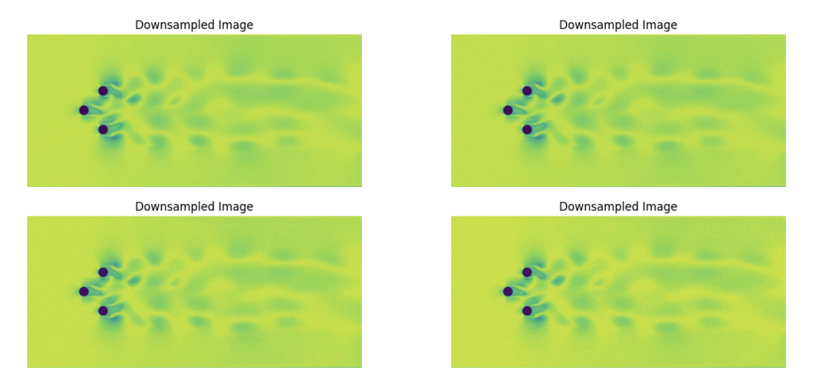
GAUSSIAN RESULTS

Slide 17
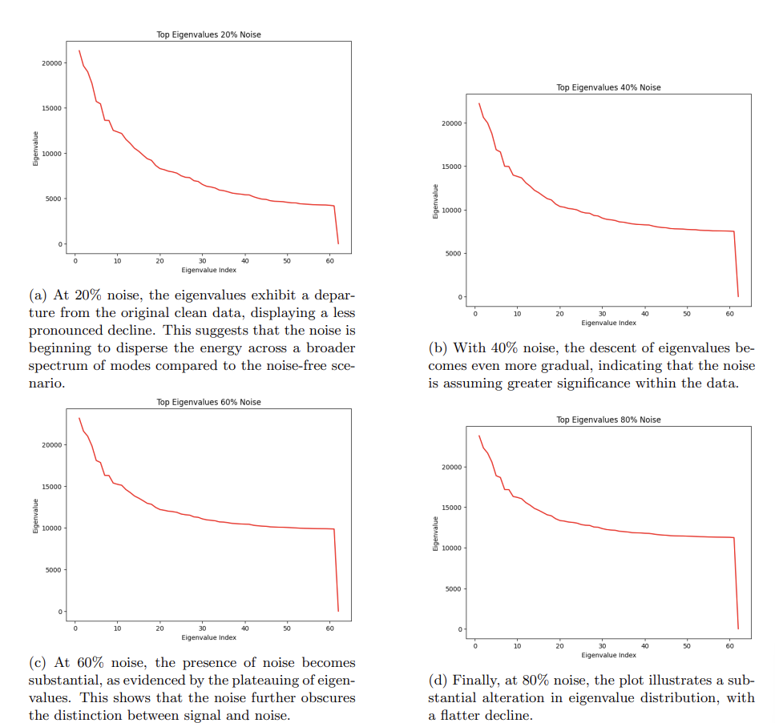
GAUSSIAN RESULTS

Slide 18
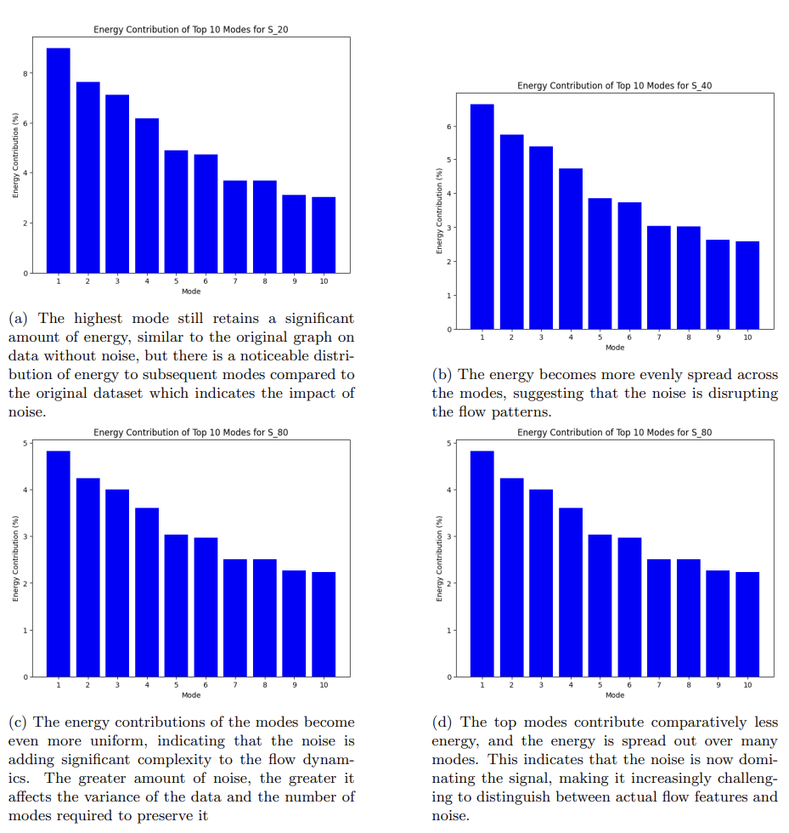
GAUSSIAN RESULTS

Slide 19
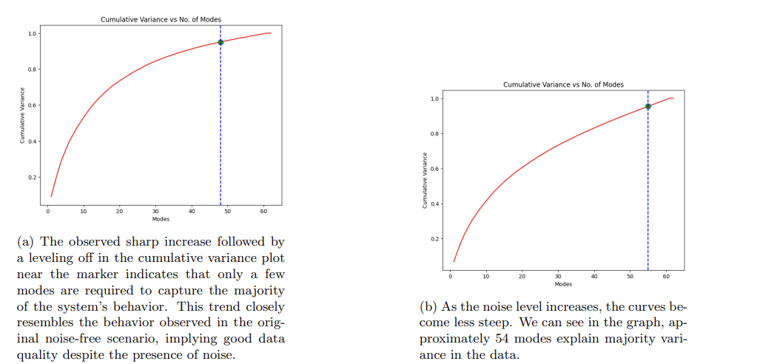
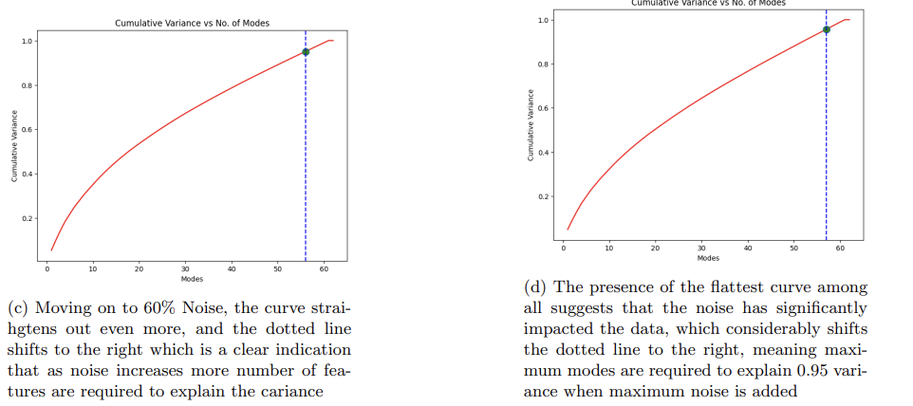
GAUSSIAN RESULTS

Slide 20
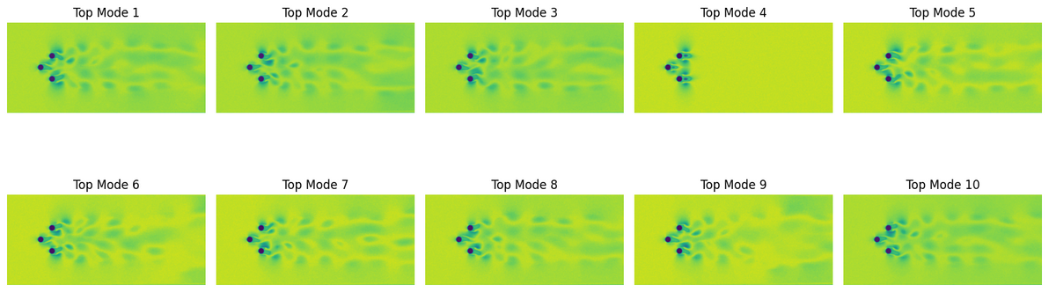
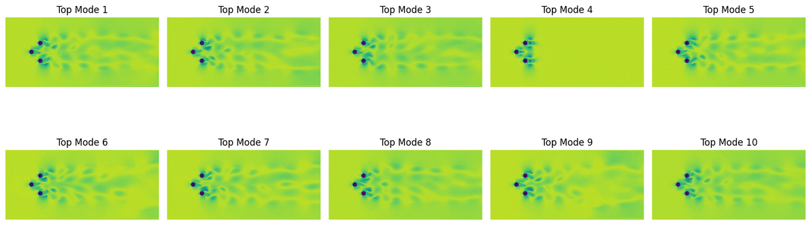
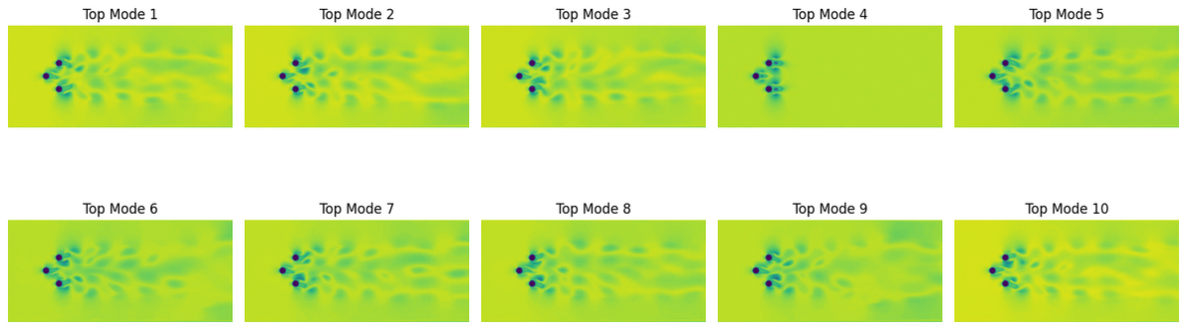
GAUSSIAN RESULTS

Slide 21
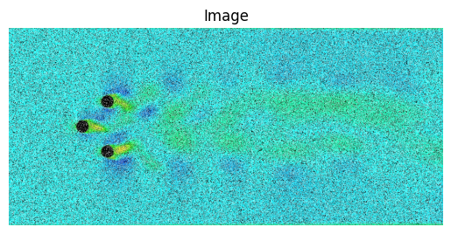
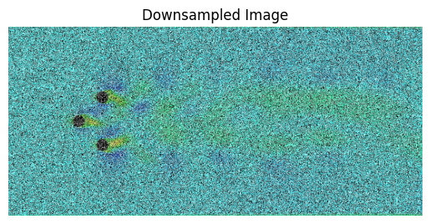
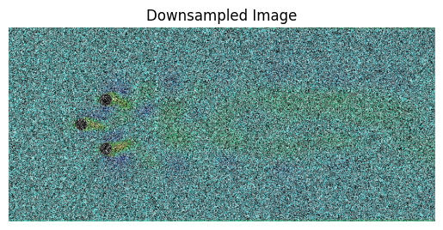
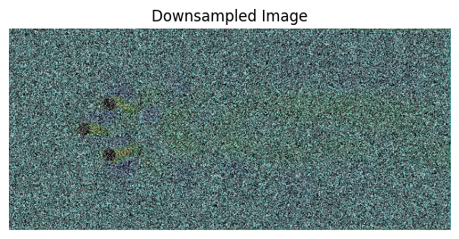
SALT PEPPER NOISE

Slide 22
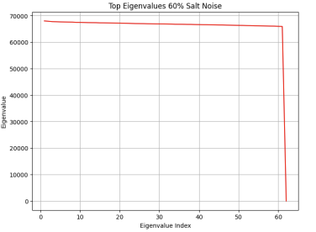
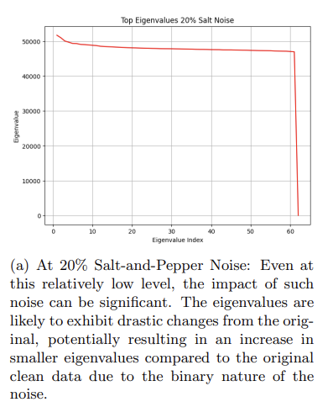
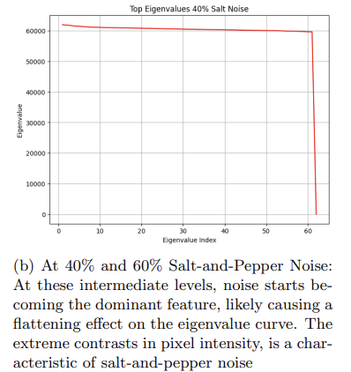
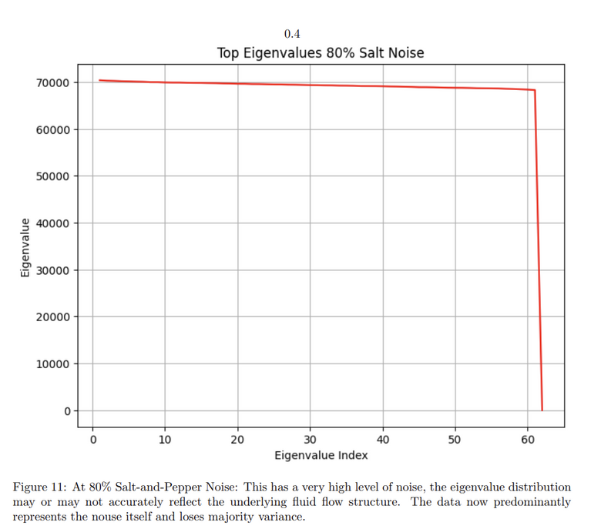
SALT PEPPER RESULTS

Slide 23
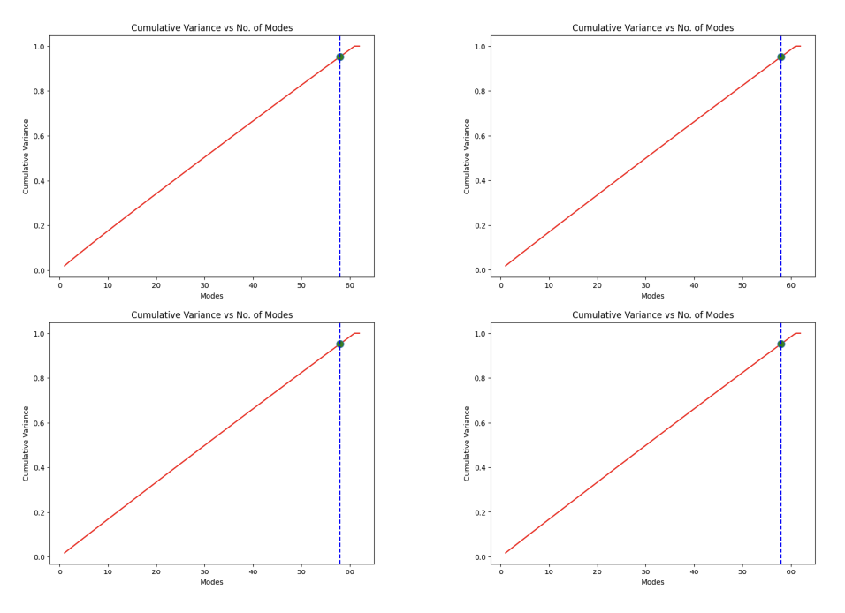
THE COMMON TREND IN THE PRESENCE OF SALT-AND-PEPPER NOISE SHOWS THAT AS THE NOISE LEVEL
INCREASES, THE CURVE FLATTENS AND MOVES TO THE RIGHT-HAND SIDE, WHICH SHOWS THAT MORE
MODES ARE NEEDED TO CAPTURE THE SAME AMOUNT OF CUMULATIVE VARIANCE. THIS SHIFT OCCURS
BECAUSE THE SALT-AND-PEPPER NOISE, WHICH INTRODUCES ARTIFICIAL HIGH-FREQUENCY COMPONENTS
INTO THE IMAGE PIXELS.

Slide 24
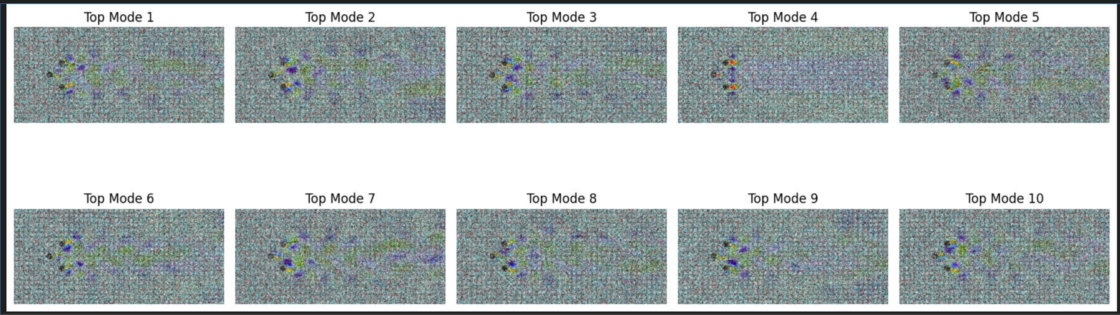
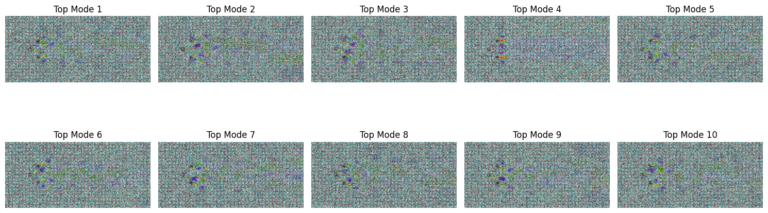
RECONSTRUCTING IMAGES

Slide 25
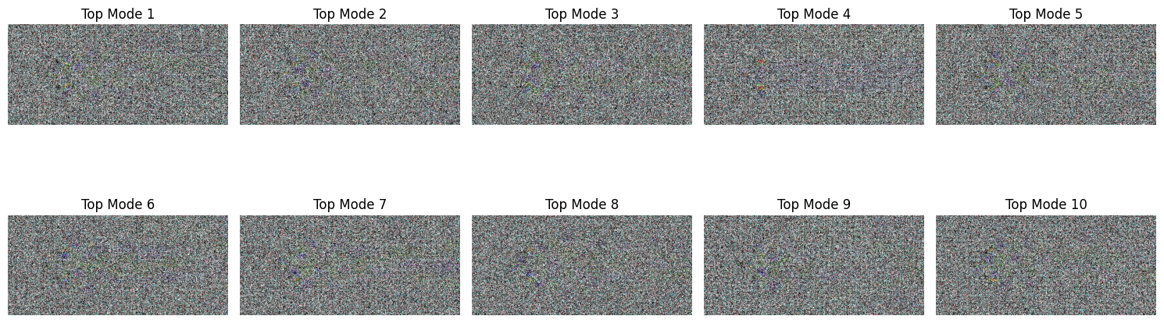
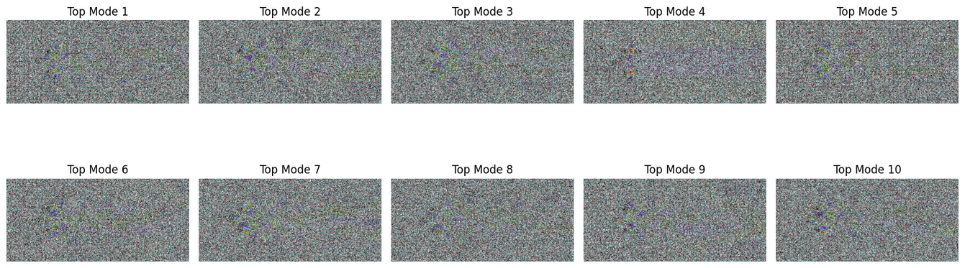
RECONSTRUCTING IMAGES
These reconstructed modes show that the quality is decreased due to noise and highlight the challenges in extracting meaningful flow dynamics as noise levels increase. In conclusion, we can say that adding noise and then removing it was a good exercise to consider how well a noise works. To say which noise suits the best is subjective- it depends on how we want it.

Slide 26
MORE SUITABLE NOISE?
As observed, the Gaussian noise increases as we increase its contribution, it does not reach a very high value of noise saturation like salt and pepper.
Hence, we can say that the Gaussian noise is better, in terms that we can evaluate our model performance more effectively, since on increasing the salt and pepper noise, the noise rises too high too fast, which is difficult for evaluation purposes.
Different noises have different effects on modes gaussian raises the no of components for 95% explained cumulative variance slowly as it is added, while the salt and pepper noise raises it to a very high value very soon, and hence the no of components to explain 95% (or some other value) cumulative variance is very high and typically remains whether the noise contribution is 20% or if it is 80%.

Slide 27
DENOISING
In close accordance with that thought process, we created new noisy images in the same way that we did in Q4. We introduced gaussian noise into the system by using the function add_gaussian_noise, where we passed input images and % noise as magnitude that would be introduced in the images. We also used the frames_with_noise function to extract frames at specified intervals and store it iteratively in separate folders namely Denoise_x, where x denotes the noise% added to the code. We hence have made four different folders where different concentration of Gaussian Noise exists. In our analysis, we have used only two noise concentrations to denoise to highlight the difference extensively of how much the different denoising methods we have employed are successful in their jobs.

Slide 28
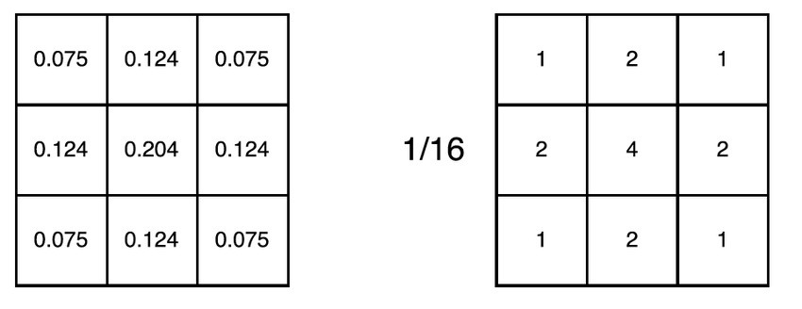
GAUSSIAN BLUR
Gaussian noise, also known as white noise, is a type of statistical noise characterized by its probability distribution following a Gaussian (normal) distribution.In the context of image processing, Gaussian noise manifests as random variations in pixel intensity values, mimicking the effects of noise present in images captured by cameras or other imaging devices.. Convolution of the gaussian kernel takes place, where the middle elements have highest weightage.

Slide 29
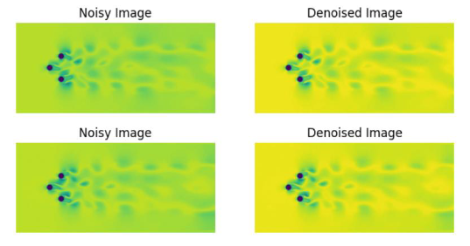
FOR 20% NOISE
We repeated the processes here again as before

Slide 30
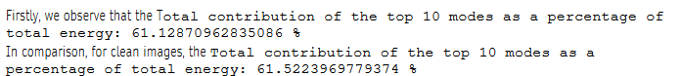
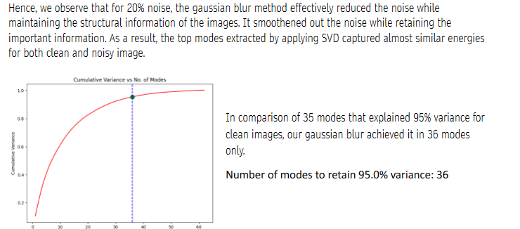

Slide 31
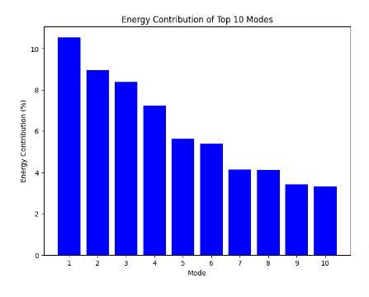
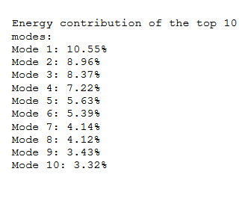

Slide 32
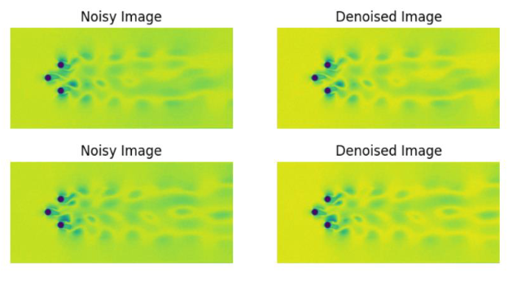
FOR 80% NOISE
To observe stark difference, we skipped analysis on 40% and 60% noise and directly did analysis on 80% noise.
We repeated the processes here again as before

Slide 33
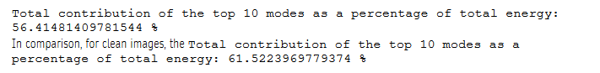
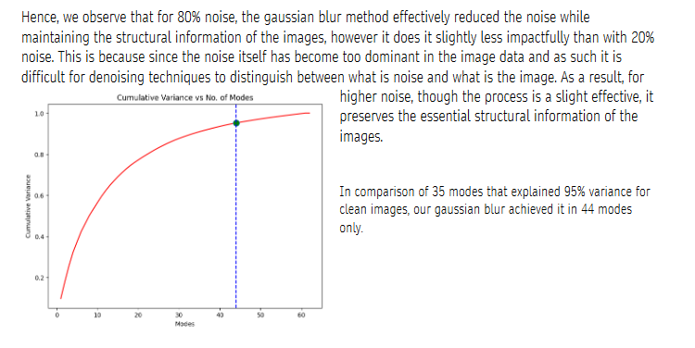

Slide 34
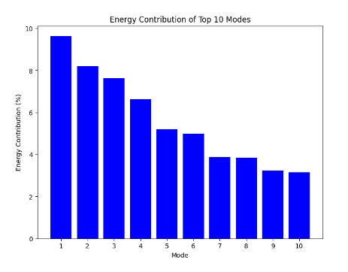
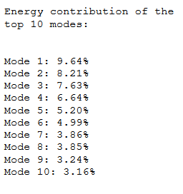

Slide 35
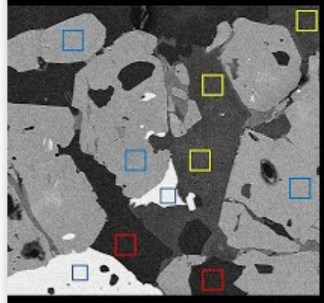
NLM DENOISING
We also considered using NLM denoising – Non-local Means Denoising, and implemented it using the function
“denoise_with_nlm”. This method effectively reduces noise while preserving important image details. We used
the cv2.fastNLMeansDenoising function from the OpenCV library to achieve our objectives. This method
accounts for similarities between different patches within the image to remove noise, while keeping structural
info contact. Overall, it improves the quality of input image.

Slide 36
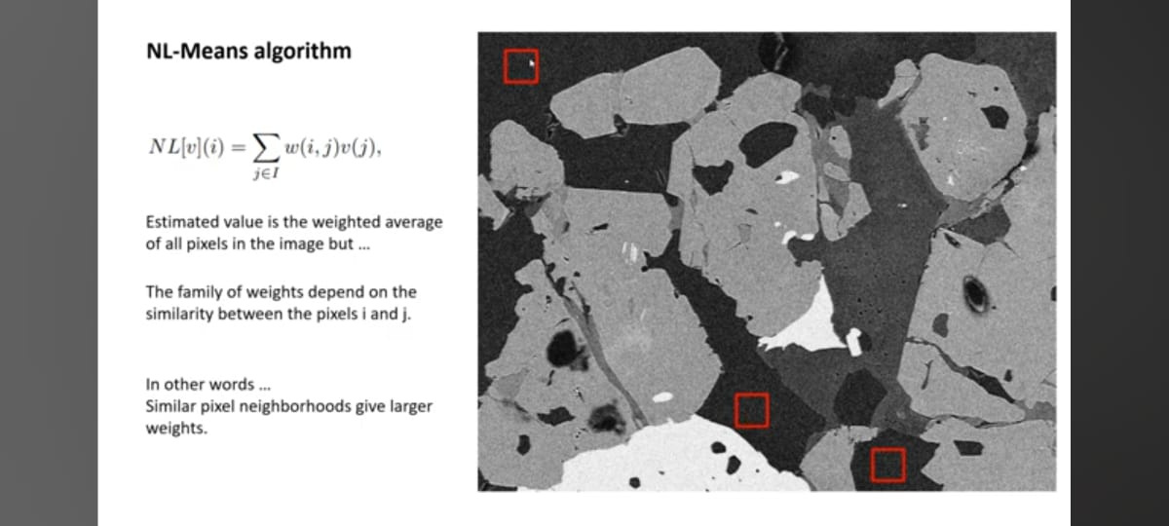
NLM DENOISING

Slide 37

FOR 20% NOISE
Here we have displayed how the function has worked. The denoised images resemble closely with the original
flow images, which is evident from the pictures attached

Slide 38



Slide 39



Slide 40

FOR 80% NOISE
To observe stark difference, we skipped analysis on 40% and 60% noise and directly did analysis on 80% noise.

Slide 41



Slide 42



Slide 43


